Slide 1
Summer Internship Project On TELECOM CUSTOMER CHURN PREDICTION
RITESH KUMAR YADAV
22A91A4442

Slide 2
Index
Abstract
Introduction
Technologies Used
Problem Statement
Solutions
Architecture Diagram
Methodology
Key Module Code
Results
Conclusion
Future Enhancements
Queries

Slide 3
Abstract
.
Customer churn analysis is the process of predicting customers who tend to cancel the service (subscription) they receive for various reasons, especially in sectors such as telecommunications, finance and insurance, and determining the necessary operational steps to prevent this cancellation. The study used two separate datasets from kaggle.com to identify customers who tend to unsubscribe in the telecommunications industry. The analysis process was carried out by applying machine learning methods such as Logistic Regression.

Slide 4
Introduction
Data Science is a multidisciplinary field that involves the use of scientific methods, processes, algorithms, and systems to extract insights and knowledge from structured and unstructured data. It combines expertise from various domains such as statistics, computer science, information theory, and domain-specific knowledge to analyze and interpret complex data sets.

Slide 5
Technologies Used
Data science
Machine learning
Python

Slide 6
Problem Statement Telecom companies often face high customer churn, where customers discontinue their services for various reasons such as dissatisfaction, better offers from competitors, or service quality issues. Churn directly affects revenue and profitability, making it essential for telecom operators to identify potential churners early and take preventive actions. The challenge is to develop a predictive model that can accurately forecast customer churn based on historical customer behavior, usage patterns, and demographics.
Tuesday, October 22, 2024

Slide 7
Goal
The goal is to build a machine learning model that predicts whether customer will churn in the near future. The model should help the telecom company in taking proactive steps like personalized offers, improved customer support, or enhances service plans to retain the customer.
Tuesday, October 22, 2024

Slide 8
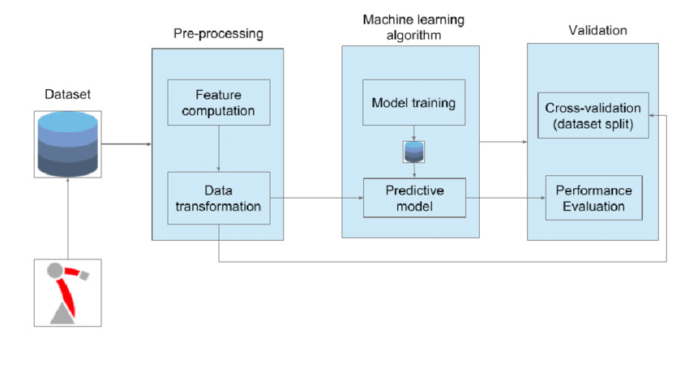
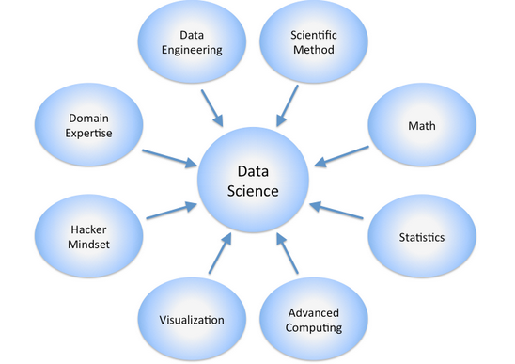
Architecture Diagram

Slide 9
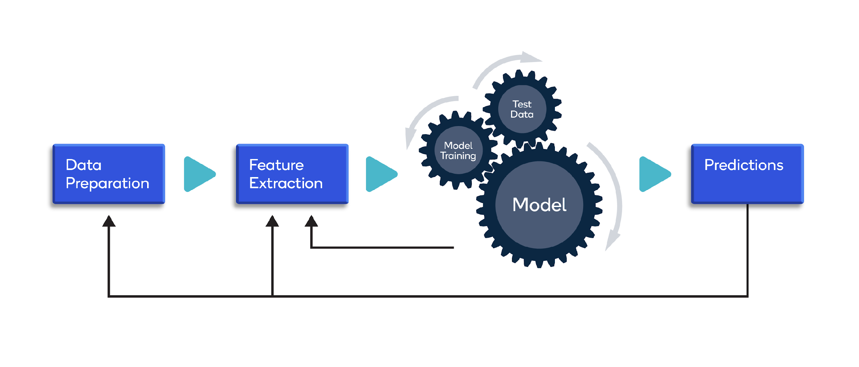
Methodology

Slide 10
Methodology
Feature Engineering:
Create new features or modify existing ones to improve model performance.
Select the most relevant features for analysis.
Exploratory Data Analysis (EDA):
Visualize and explore data patterns, trends, and relationships.
Identify outliers and anomalies.
Model Development:
Select appropriate algorithms based on the problem and data.
Split the data into training and testing sets.
Train and validate the model using the training set.

Slide 11
Communication of Results:
Summarize findings and insights.
Create visualizations and reports for different stakeholders.
Clearly communicate the implications of the results for decision-making.
Feedback and Iteration:
Gather feedback from stakeholders.
Iterate on the model or analysis based on feedback and new data.
Continuously improve and update models as needed.

Slide 12
Key Module Code
import pandas as pd
import numpy as np
import matplotlib.pyplot as plt
Import seaborn as sns
data = pd.read_csv("/content/WA_Fn-UseC_-Telco-Customer-Churn.csv")
X = data2.drop('Churn', axis=1)
y = data2['Churn’]
from sklearn.model_selection import train_test_split
x_train, x_test, y_train, y_test = train_test_split(x, y, test_size = 0.3)

Slide 13
Key Module Code
from sklearn.linear_model import LogisticRegression
log = LogisticRegression()
log.fit(X_train, y_train)
log_y_pred = log.predict(X_test)
log_y_pred_train = log.predict(X_train)
log_test_as = metrics.accuracy_score(log_y_pred, y_test)
log_train_as = metrics.accuracy_score(log_y_pred_train, y_train)
print(metrics.classification_report(log_y_pred, y_test))

Slide 14
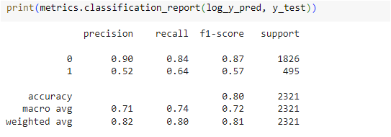
Results

Slide 15
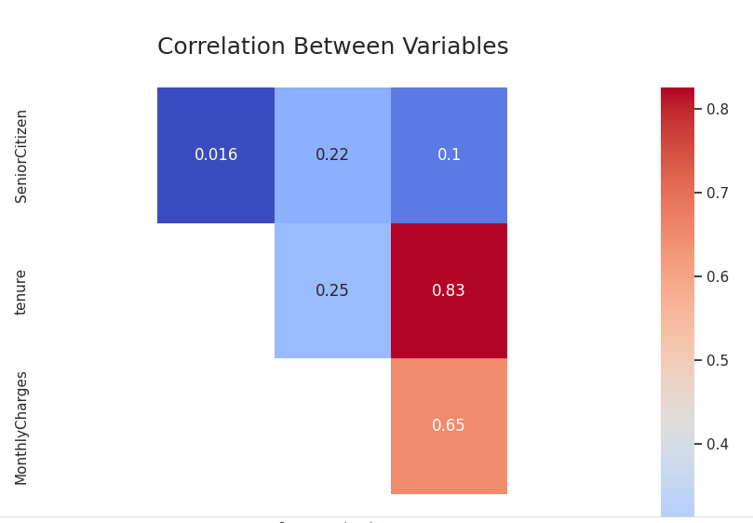
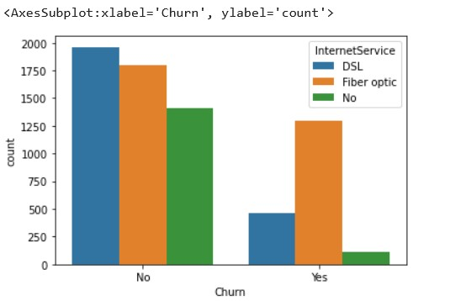
Results

Slide 16
Conclusion
Creating more targeted and effective retention strategies is one of the main advantages of customer churn prediction analysis. By examining customer data, which enables them to spot trends and patterns in consumer behavior, businesses may better understand the needs and preferences of their customers

Slide 17
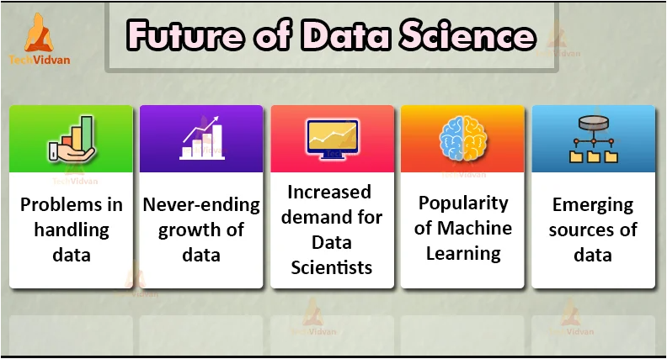
Future Enhancements

Slide 18
QUERIES ?

Slide 19
Thank you.
Tuesday, October 22, 2024

